Slide 1


Step by Step Instructions

Slide 2
Content
How to get your account
How to Login
How to take my Quizzes and Exams
How to report Errors
Queries and Clarifications

Slide 3
HOW TO GET YOUR ACCOUNT?
For those new students kindly send us your WORKING GMAIL ACCOUNT AND FULLNAME in our Facebook page “ACLC College of Marbel”.
For our old students your account is the same as last semester.

Slide 4
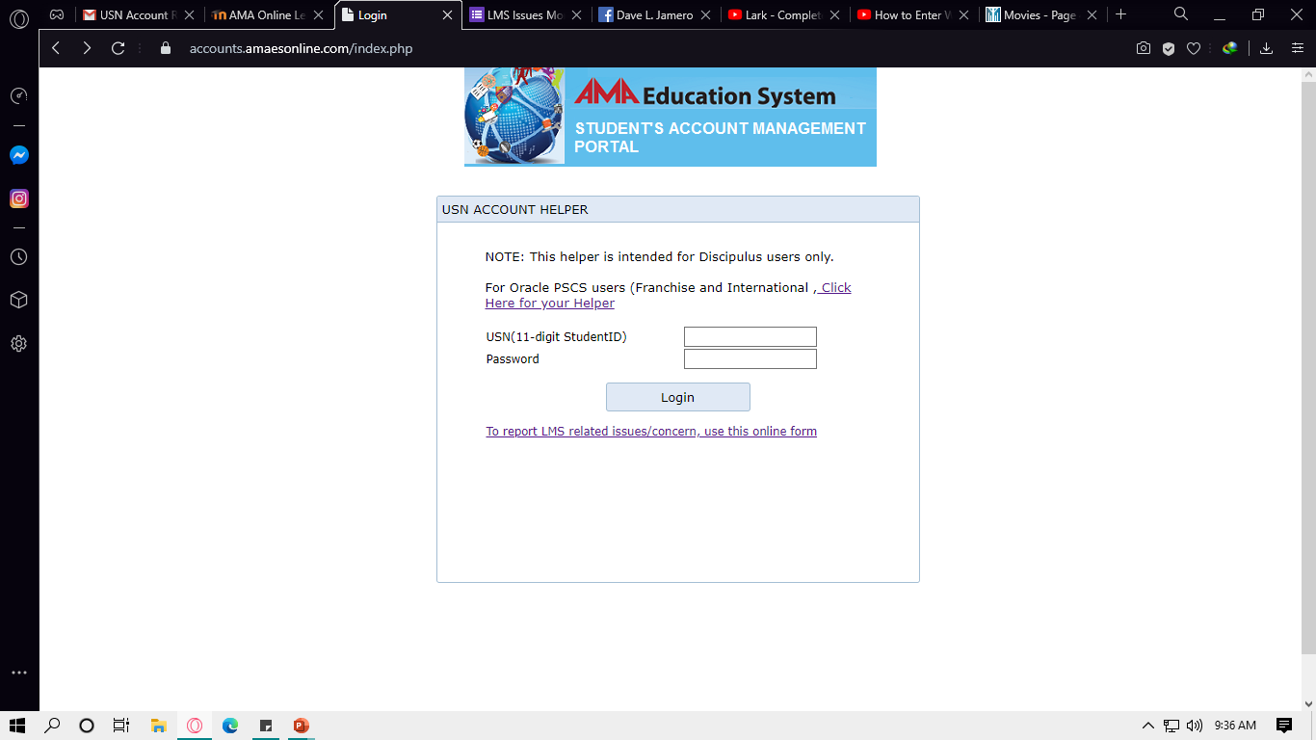
HOW TO LOGIN?
Step 1. Access “accounts.amaesonline.com” input your username and password then click Login.
Note: Once lang dri mag login, after that pwede na mag direct sa “topsite” or your portal and dapat naka lowercase ang pass.

Slide 5
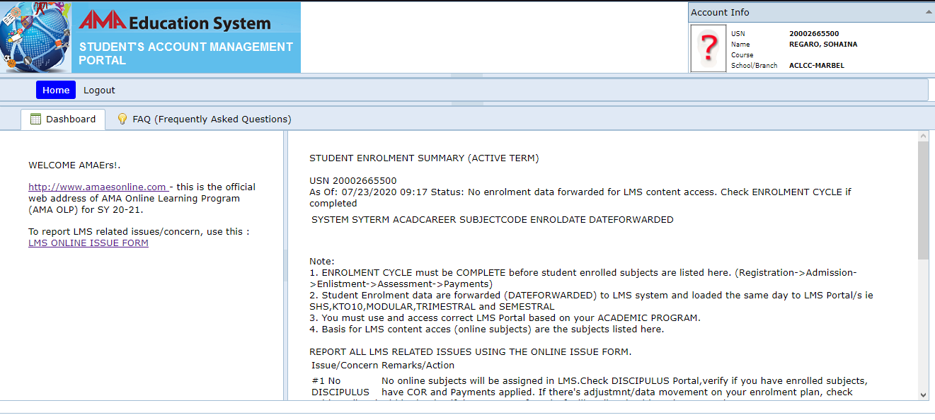
HOW TO LOGIN?
Step 2. After you Login click the link “http://www.amaesonline.com”

Slide 6
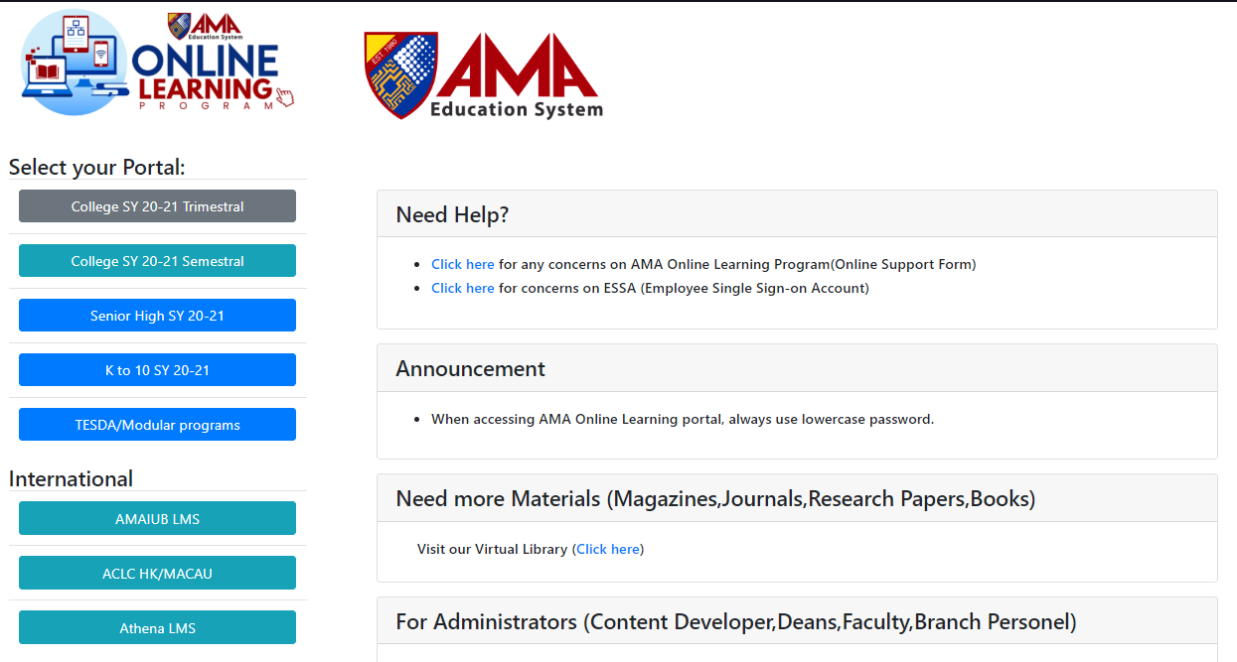
HOW TO LOGIN?
Step 3. Click “Senior High SY 20-21

Slide 7
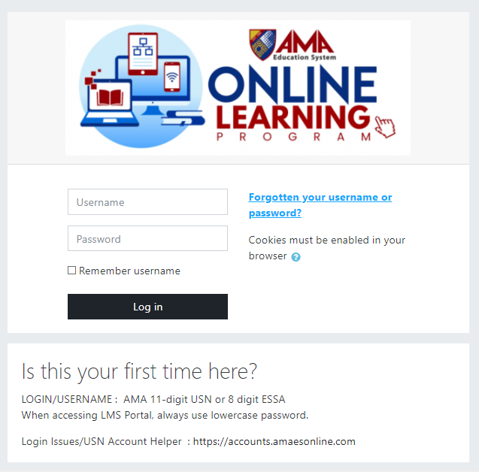
HOW TO LOGIN?
Step 4. Input your username and password
Note: Dapat naka lowercase ang pass

Slide 8
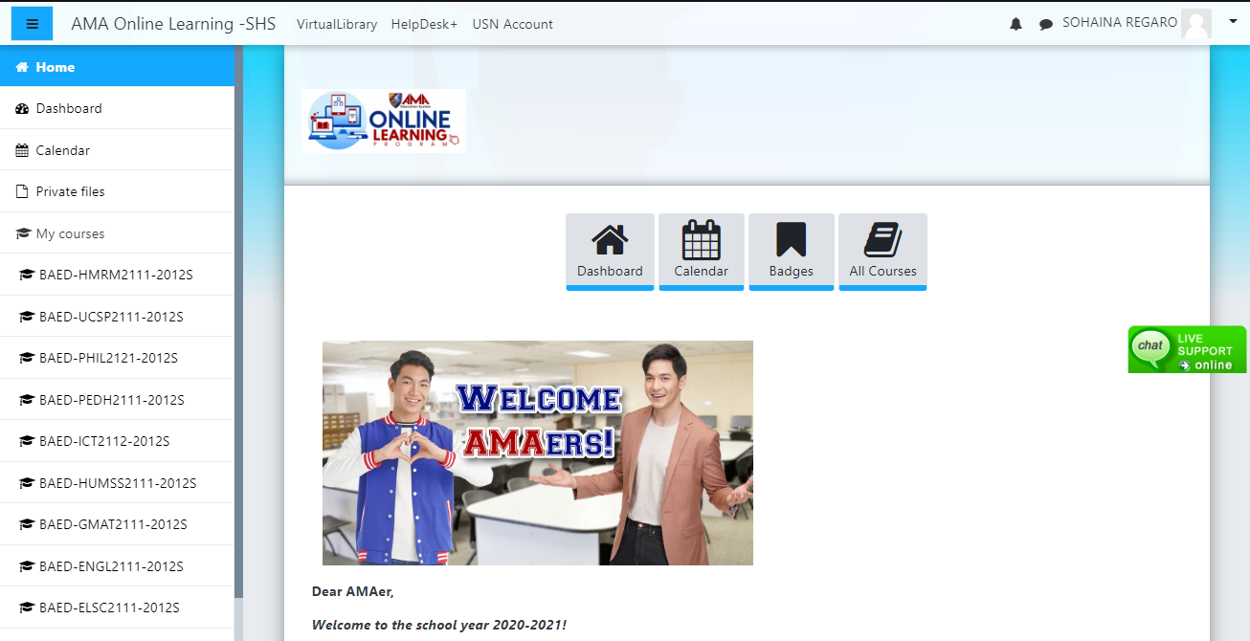
HOW TO TAKE MY QUIZZES AND EXAMS?

Slide 9
HOW TO REPORT ERRORS?

Slide 10
QUERIES AND CLARIFICATIONS

Slide 11
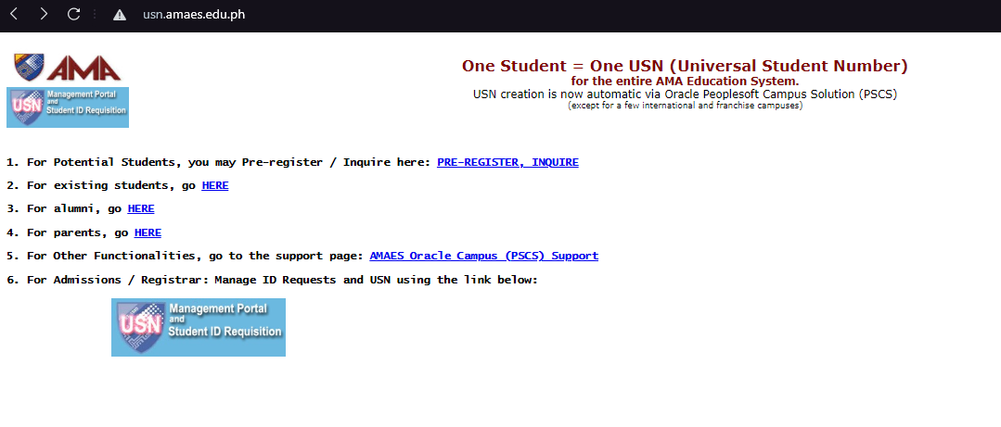
HOW TO SEND ACCOUNTS TO STUDENT
Access “usn.amaes.edu.ph”

Slide 12
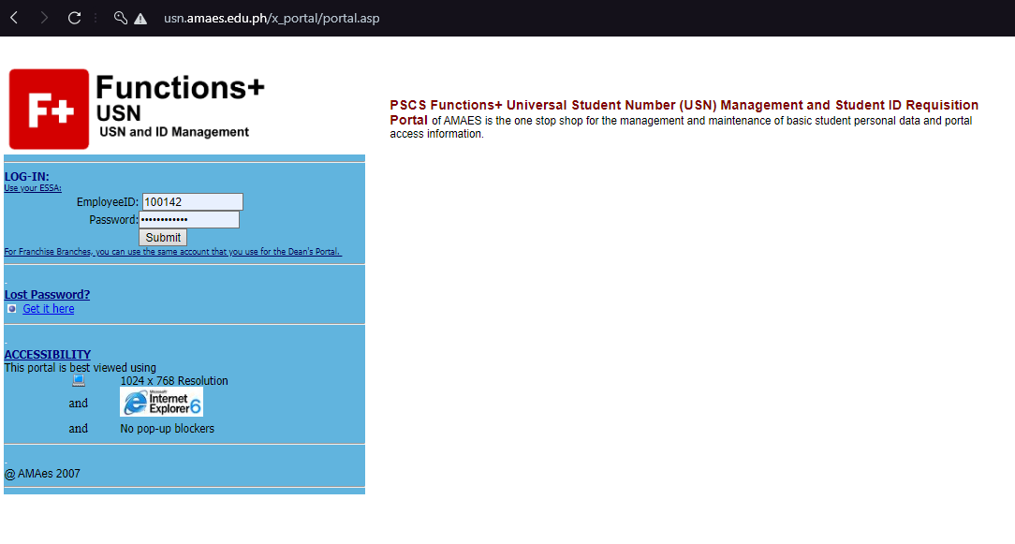
HOW TO SEND ACCOUNTS TO STUDENT
Login “username – 100142, password – amvpagarigan”

Slide 13
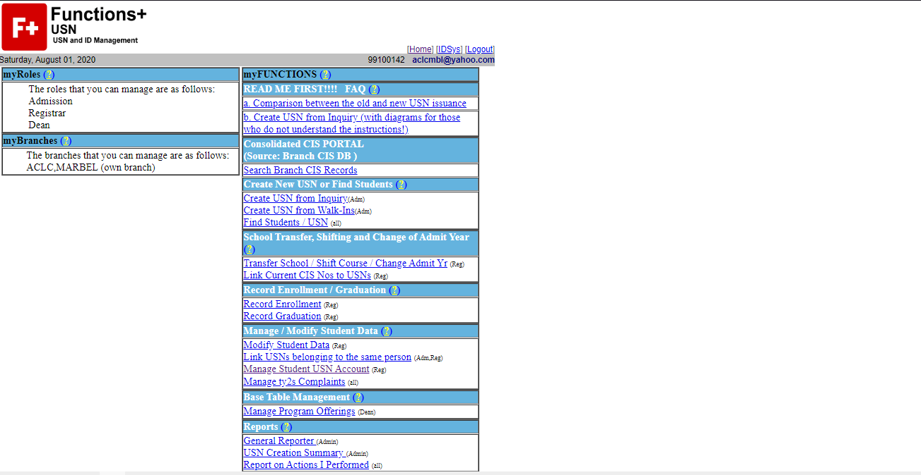
HOW TO SEND ACCOUNTS TO STUDENT
Manage student USN account

Slide 14
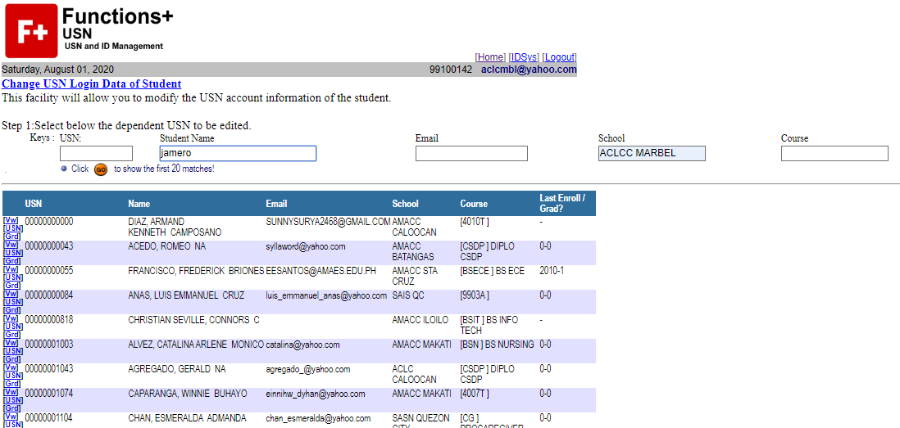
HOW TO SEND ACCOUNTS TO STUDENT
Enter textbox Name and School

Slide 15
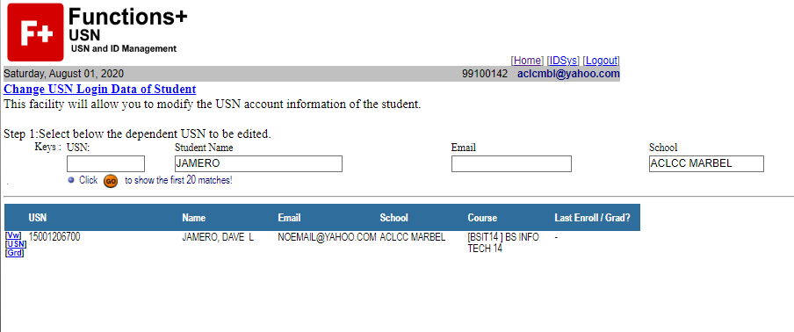
HOW TO SEND ACCOUNTS TO STUDENT
Click USN

Slide 16
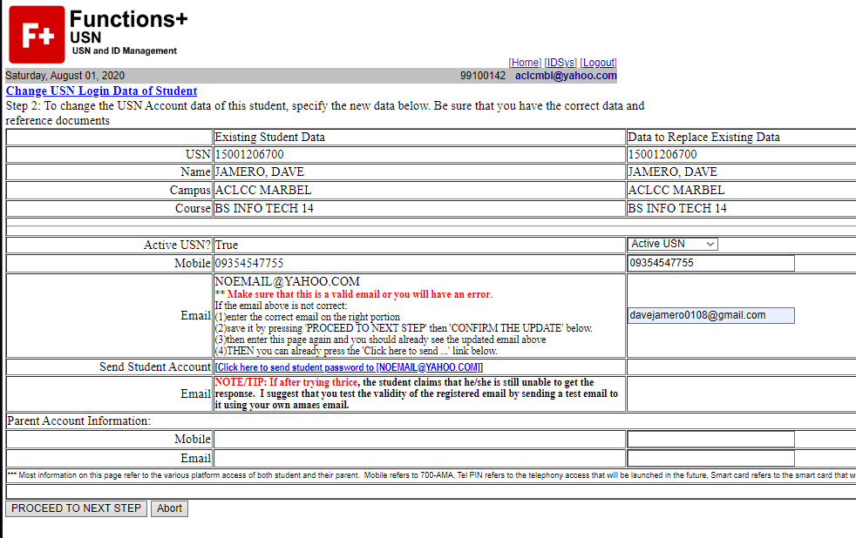
HOW TO SEND ACCOUNTS TO STUDENT
Enter email, click proceed

Slide 17
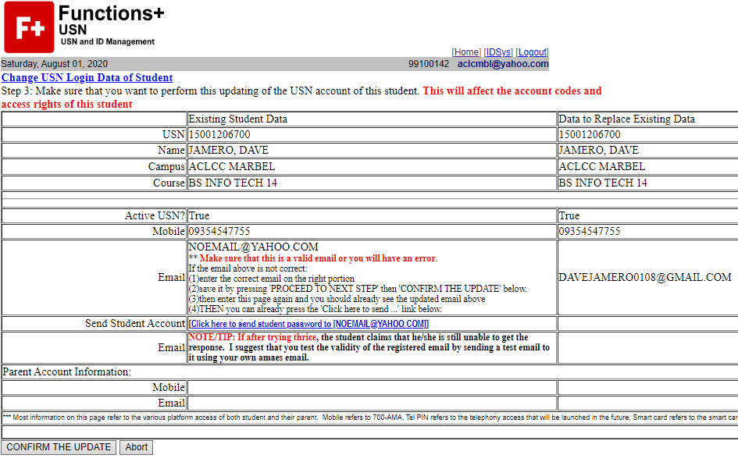
HOW TO SEND ACCOUNTS TO STUDENT
Click confirm the update

Slide 18
HOW TO SEND ACCOUNTS TO STUDENT
Again enter textbox Name and School

Slide 19
HOW TO SEND ACCOUNTS TO STUDENT
Click again the USN

Slide 20
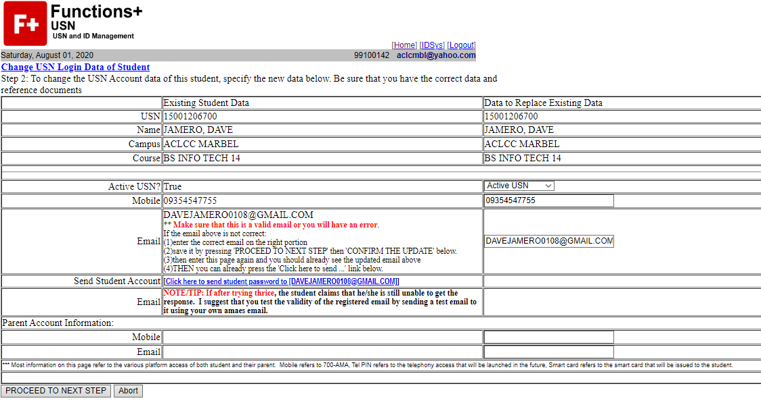
HOW TO SEND ACCOUNTS TO STUDENT
Click the link to send the email with their usernamen and password

